Slide 1


World Happiness & Access to Water
Serap Basaran, Kim Crine, Rick Kassing & Felicia Williams

Slide 2
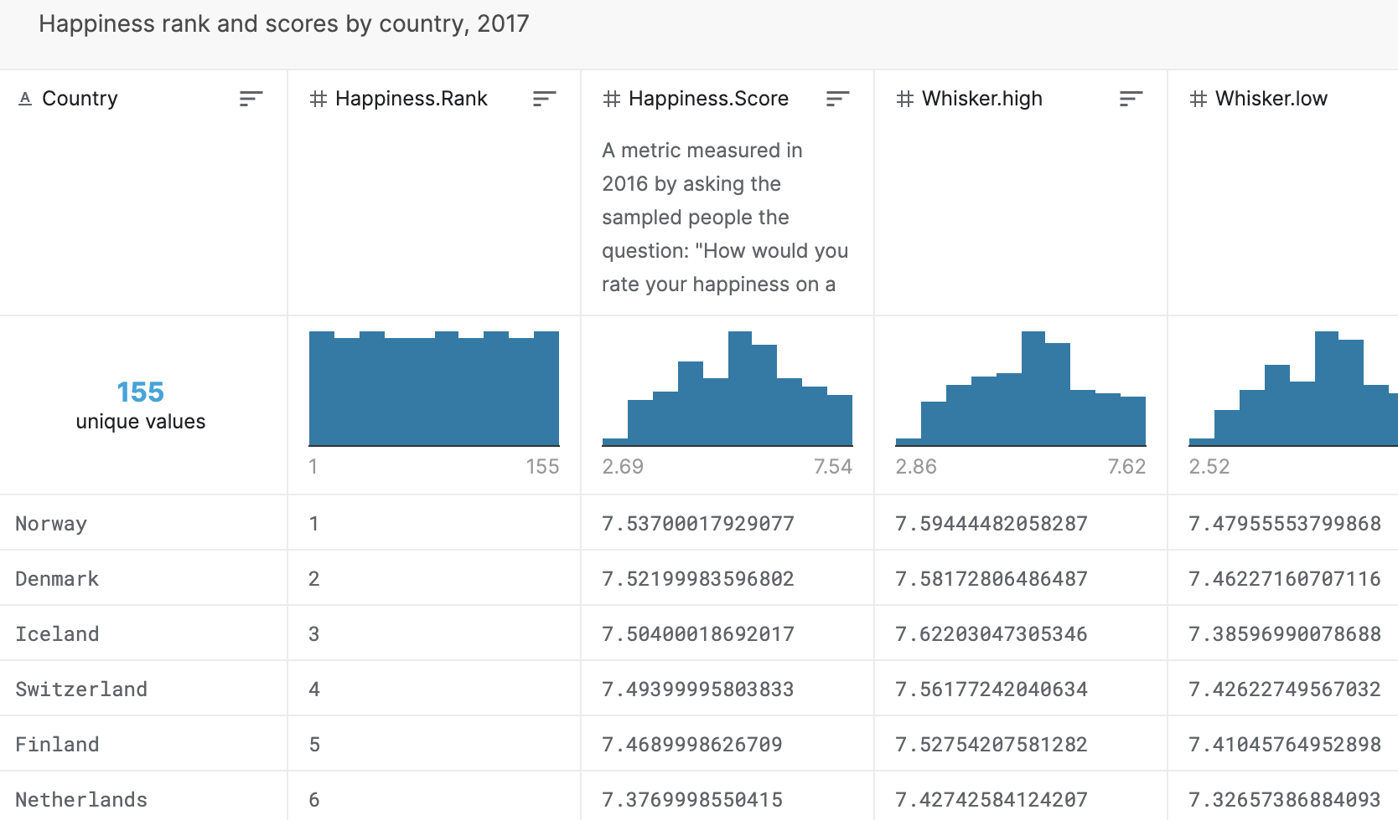
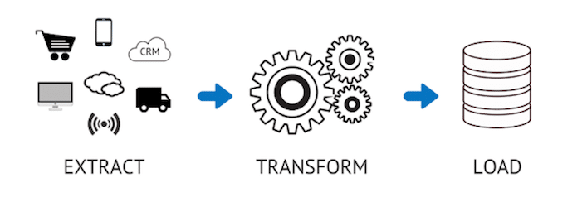
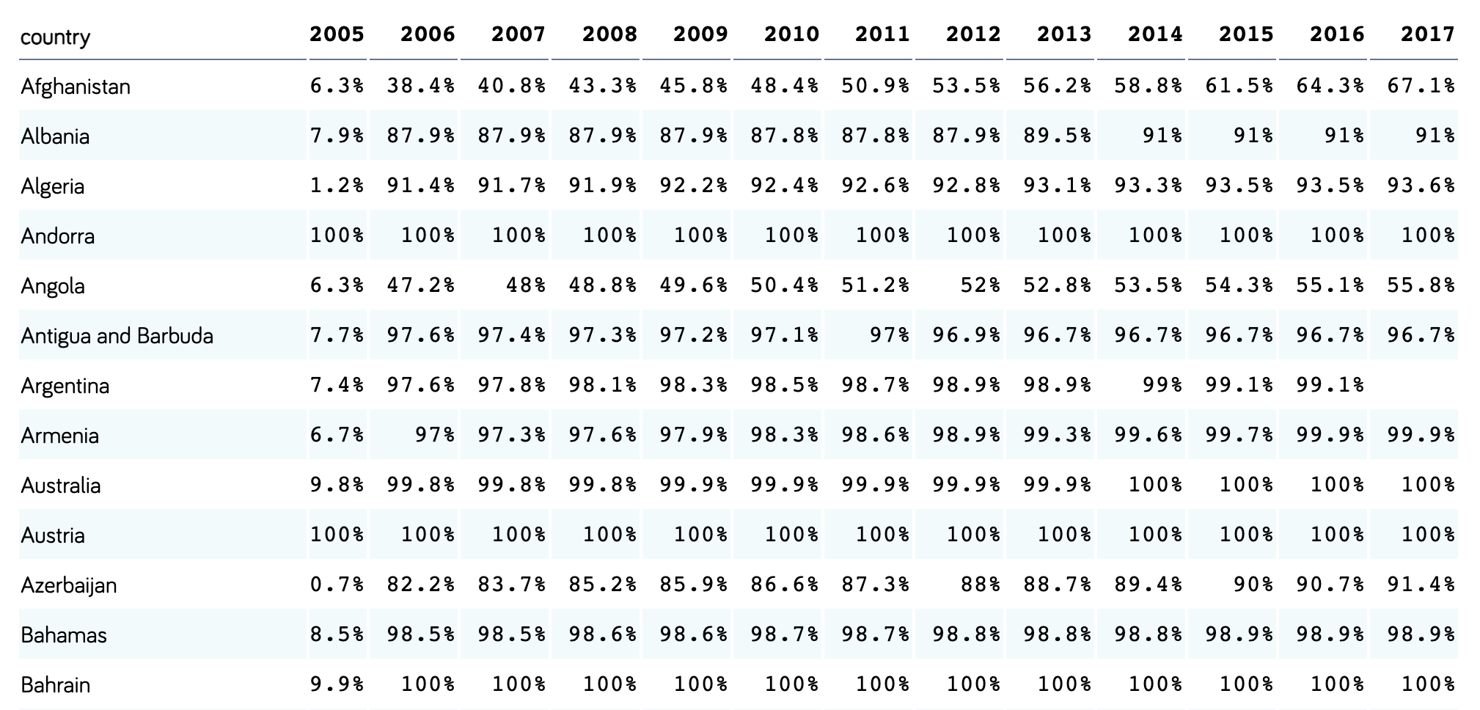
Extract
Data sources:
Kaggle - World Happiness
Gapminder - Access to Water
Annual Reports sorted by Country
Columns of interest:
Happiness Index Rating
Water Access Index
Notes:
E
Where is data coming from?
How quickly is it moving?
What level of granularity is it coming through with?

Slide 3
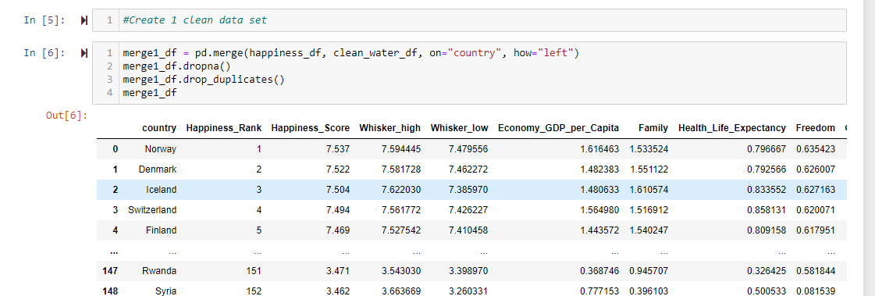
Transform
Used Pandas functions in Jupyter Notebook to load CSV files
Reviewed files and transformed into dataframes
Performed a left merge (prioritizing World Happiness data) and removed rows with duplicate, missing or irrelevant data
World Happiness dataset had less countries reporting data than the Access to Water dataset
Cleaned Country names based on latest political alignments for merging
Notes:
T
What do I want to change about the data?
What am I adding to this data from elsewhere?
How do we want to aggregate or shape this data?

Slide 4
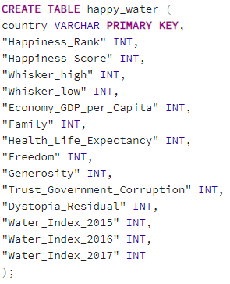
Load
Used pgAdmin to create empty tables to hold data
Connected to local database and used pandas to load csv and converted DataFrame into database
Potential Analysis Options:
Correlation between happiness and access to water (hypothesis 1:1 ratio)
Group by Region for correlation analysis
Pull in additional years of happiness data to understand trends
Notes:
L
Where is the data going?
When should I send it/how quickly?
Is the data I’m sending accurate and useful?

